Slide 1
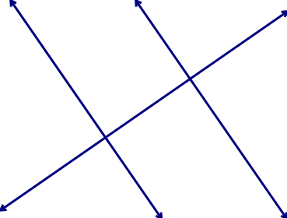
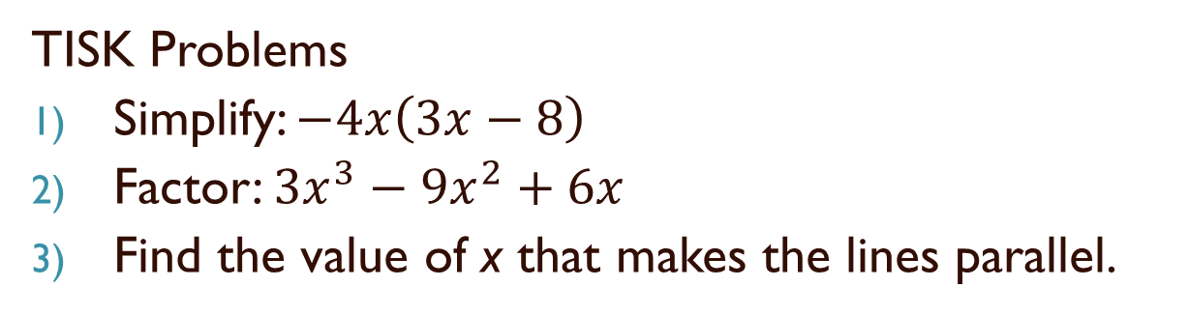


Wednesday, October 24, 2012
TISK Problems
Simplify: $−4x\left(3x−8\right)$
Factor: ${3x}^{3}−9x^{2}+6x$
Find the value of x that makes the lines parallel.
$$\left(2x+45\right)°$$
$$4x°$$
We will have 2 Mental Math Questions today.
Homework: p. 219 #30-34 even and 33
Notes:
Mental Math
1.) Start with the square of 6. Double it. Divide by 12. Cube it. Take one-ninth. (24)
2.) Start with the square of 9. Double it. Divide by 6. Take the cube root. (3)

Slide 2




§4-5 More Congruent Triangles
Prove: AAS
D
Prove: SSA
B
E
A
C
F
Given: $∠A≅∠D$, $∠B≅∠E$, $\overline{BC}≅\overline{EF}$
Given: $\overline{BC}≅\overline{EF}$, $\overline{AB}≅\overline{DE},∠C≅∠F$
Prove: $∆ABC≅∆DEF$
Prove: $∆ABC≅∆DEF$

Slide 3
Ways to Prove Triangles Congruent
Def. of Congruent Triangles
  CPCTC: Corresponding Parts of Congruent Triangles are Congruent
  If corresponding parts are congruent, triangles are congruent
SSS Postulate
SAS Postulate
ASA Postulate
AAS Theorem
  If two angles and a non-included side of one triangle are congruent to two angles and a non-included side of another triangle, then the triangles are congruent.

Slide 4
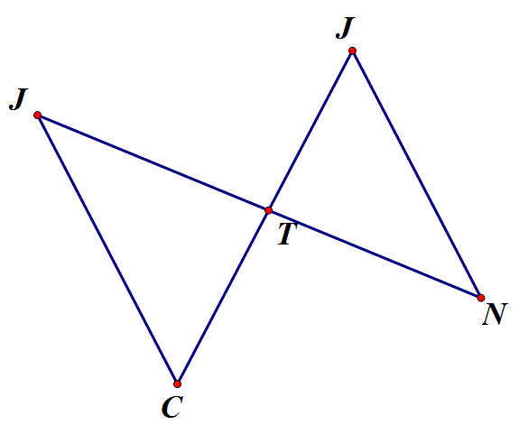

Example
Given: $\overline{JC}∥\overline{NH}$ and $\overline{CH}$ bisects $\overline{JN}$
Prove: $∆CTJ≅∆HTN$
H
1
2

Slide 5
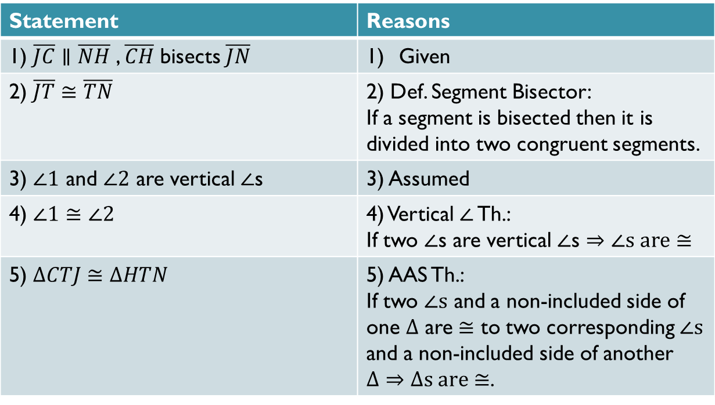
Proof
Statement | Reasons
1) $\overline{JC}∥\overline{NH}$ , $\overline{CH}$ bisects $\overline{JN}$ | Given
2) $\overline{JT}≅\overline{TN}$ | 2) Def. Segment Bisector: If a segment is bisected then it is divided into two congruent segments.
3) $∠1$ and $∠2$ are vertical $∠$s | 3) Assumed
4) $∠1≅∠2$ | 4) Vertical $∠$ Th.: If two $∠$s are vertical $∠$s $⇒∠s are≅$
5) $∆CTJ≅∆HTN$ | 5) AAS Th.: If two $∠s$ and a non-included side of one $Δ$ are $≅$ to two corresponding $∠s$ and a non-included side of another $Δ⇒Δs are≅$.

Slide 6
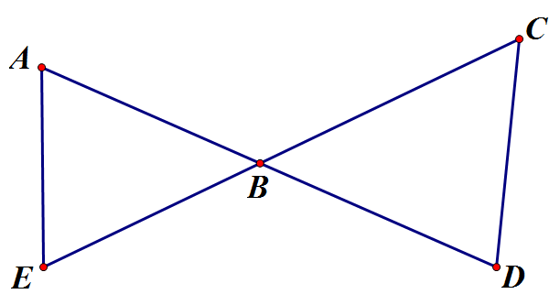
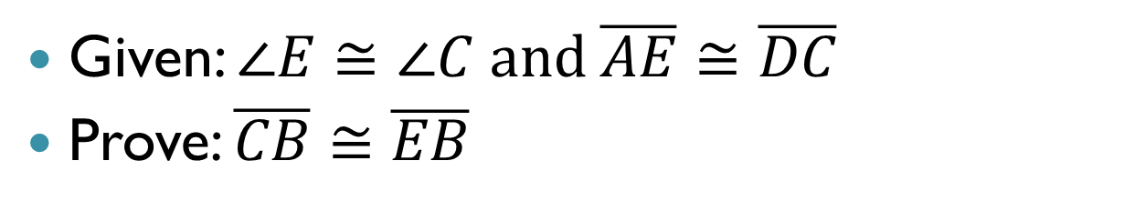
Example
Given: $∠E≅∠C and \overline{AE}≅\overline{DC}$
Prove: $\overline{CB}≅\overline{EB}$
1
2

Slide 7
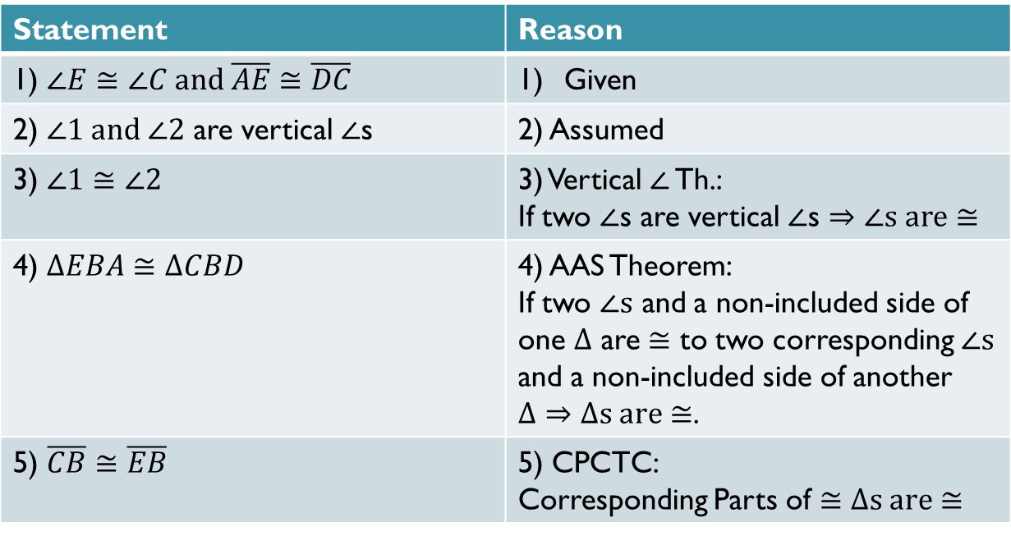
Proof
Statement | Reason
1) $∠E≅∠C and \overline{AE}≅\overline{DC}$ | Given
2) $∠1 and ∠2$ are vertical $∠$s | 2) Assumed
3) $∠1≅∠2$ | 3) Vertical $∠$ Th.: If two $∠$s are vertical $∠$s $⇒∠s are≅$
4) $ΔEBA≅ΔCBD$ | 4) AAS Theorem: If two $∠s$ and a non-included side of one $Δ$ are $≅$ to two corresponding $∠s$ and a non-included side of another $Δ⇒Δs are≅$.
5) $\overline{CB}≅\overline{EB}$ | 5) CPCTC: Corresponding Parts of $≅Δs are≅$

